Slide 1
A 1.42TOPS/W Deep Convolutional Neural Network Recognition Processor for Intelligent IoE Systems
周益
03/28/2019

Slide 2
Key Features
Neural Processing Engine (NPE)
Dual-Range Multiply-Accumulate Block (DRMAC)
Architectural/Algorithm-level Off-chip Memory Access Reduction Scheme

Slide 3
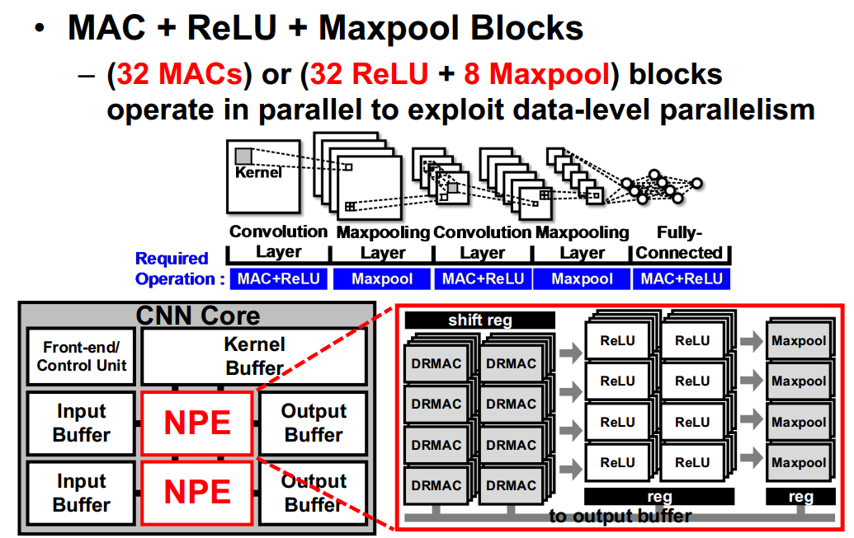
Neuron Processing Engine

Slide 4
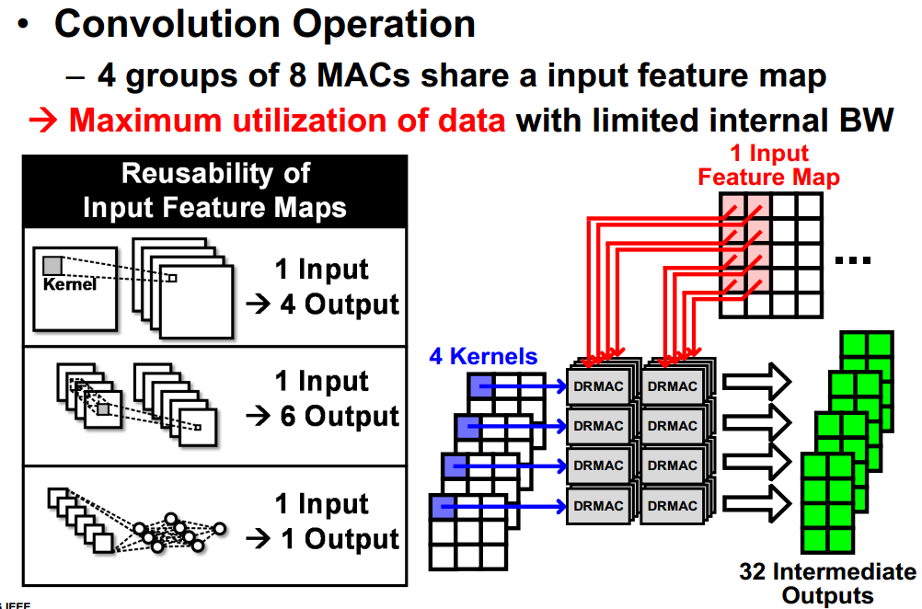
Neuron Processing Engine

Slide 5
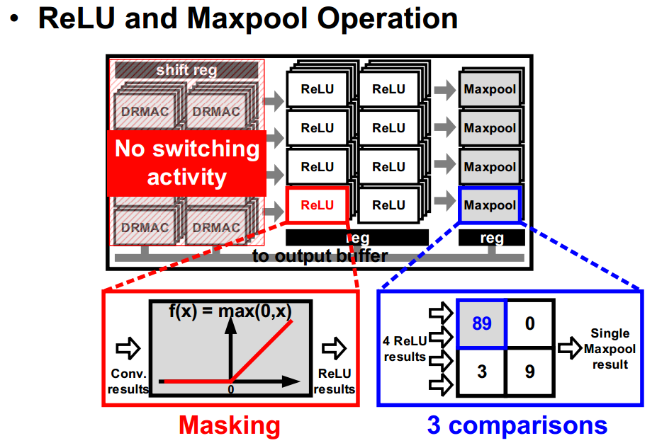
Neuron Processing Engine

Slide 6
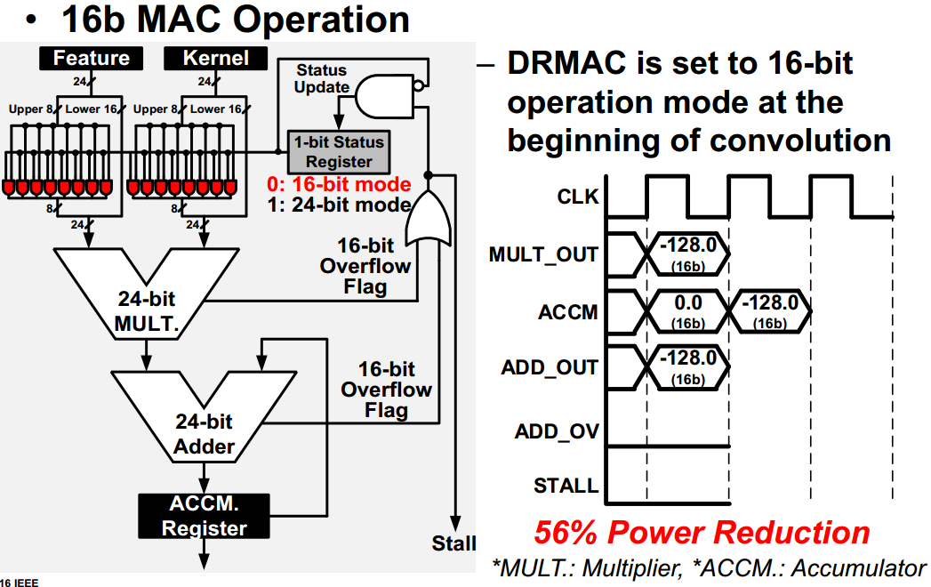
Dual-Range Multiply-Accumulate

Slide 7
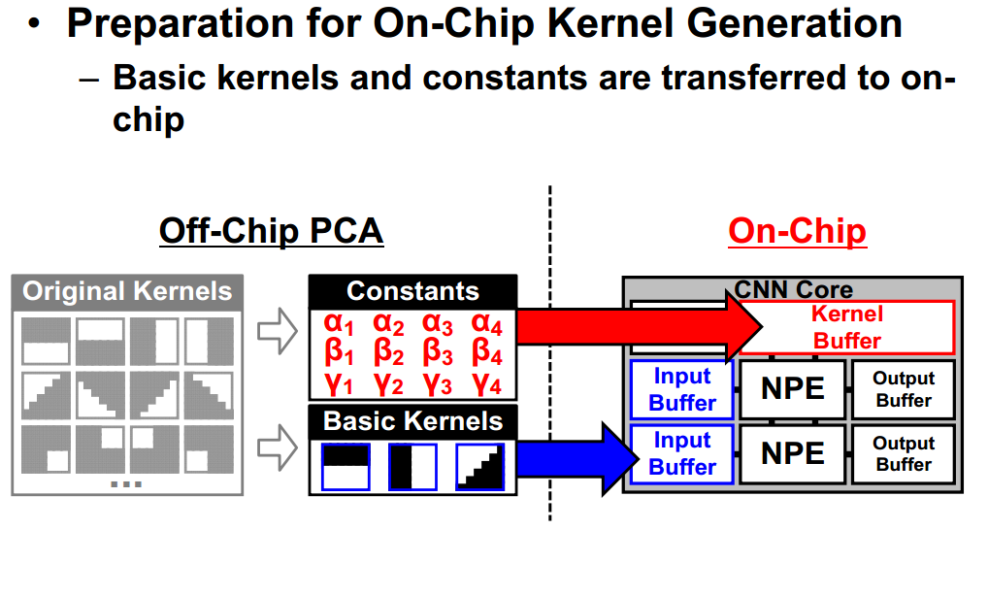
On-Chip Kernel Generation

